Slide 1
CHAPTER 3:
Managing Design Processes
Designing the User Interface:
Strategies for Effective Human-Computer Interaction
Fifth Edition
Ben Shneiderman & Catherine Plaisant
in collaboration with
Maxine S. Cohen and Steven M. Jacobs
[slides modified by S. Dascalu for CS 420/620 classroom use at UNR, Fall 2012]

Slide 2
Outline
Organizational Design to Support Usability
The Four Pillars of Design
Development Methodologies
Ethnographic Observation
Participatory Design
Scenario Development
Social Impact Statement & Legal Issues
Development Processes [+]
2-<number>

Slide 3
Organizational Design to Support Usability
Design is inherently creative and unpredictable. Interactive system designers must blend knowledge of technical feasibility with a mystical esthetic sense of what attracts users.
Carroll and Rosson design characterization:
  Design is a process, not a state.
  The design process is nonhierarchical.
  The process is radically transformational.
  Design intrinsically involves the discovery of new goals.
3-<number>

Slide 4
Organizational Design to Support Usability
Usability engineering has evolved into a recognized discipline with maturing practices and a growing set of standards
Usability engineers and user-interface architects, sometimes called the user experience (UX) team are gaining experience in organizational change
There are numerous papers and reporting addressing return on investment (ROI) for usability testing
The Usability Professional's Association (UPA) holds annual meetings called the “World Usability Day”
3-<number>

Slide 5
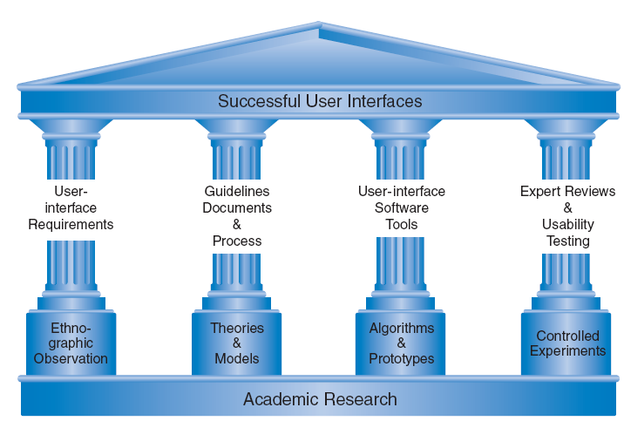
The Four Pillars of Design
3-<number>

Slide 6
The Four Pillars of Design
User Interface Requirements
  Soliciting and clearly specifying user requirements is a major key to success in any development activity
  Laying out the user-interface requirements is part of the overall requirements development and management process
  User interface requirements describe system behavior
Ethnographic Observation
  Identifying and observing the user community in action
  Discussed later
3-<number>

Slide 7
The Four Pillars of Design
Guidelines documents and processes
Each project has different needs, but guidelines should be considered for:
  Words, icons, and graphics
    Terminology (objects and actions), abbreviations, and capitalization
    Character set, fonts, font sizes, and styles (bold, italic, underline)
    Icons, graphics, line thickness, and
    Use of color, backgrounds, highlighting, and blinking
3-<number>

Slide 8
The Four Pillars of Design (cont.)
  Screen-layout issues
    Menu selection, form fill-in, and dialog-box formats
    Wording of prompts, feedback, and error messages
    Justification, white space, and margins
    Data entry and display formats for items and lists
    Use and contents of headers and footers
  Input and output devices
    Keyboard, display, cursor control, and pointing devices
    Audible sounds, voice feedback, touch input, and other special devices
    Response time for a variety of tasks
3-<number>

Slide 9
The Four Pillars of Design (cont.)
  Action sequences
    Direct-manipulation clicking, dragging, dropping, and gestures
    Command syntax, semantics, and sequences
    Programmed function keys
    Error handling and recovery procedures
  Training
    Online help and tutorials
    Training and reference materials
    Command syntax, semantics, and sequences
3-<number>

Slide 10
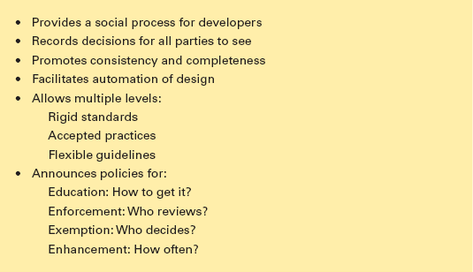
The Four Pillars of Design (cont.)
Guidelines creation should be a social process within an organization
to help it gain visibility and build support
3-<number>

Slide 11
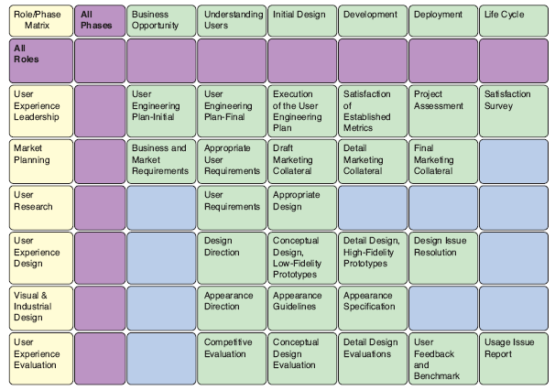
Developmental Methodologies
IBM’s Ease of Use development methodology
specifies activities by roles and phases
3-<number>

Slide 12
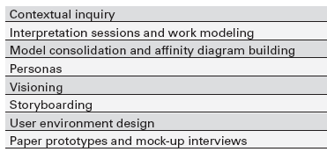
Rapid Contextual Design
From Holtzblatt, et al., Rapid Contextual Design:
A How-To Guide to Key Techniques for User-Centered Design
3-<number>

Slide 13
Ethnographic Observation
Preparation
  Understand organization policies and work culture
  Familiarize yourself with the system and its history
  Set initial goals and prepare questions
  Gain access and permission to observe/interview
Field Study
  Establish rapport with managers and users
  Observe/interview users in their workplace and collect subjective/objective quantitative/qualitative data
  Follow any leads that emerge from the visits
3-<number>

Slide 14
Ethnographic Observation (cont.)
Analysis
  Compile the collected data in numerical, textual, and multimedia databases
  Quantify data and compile statistics
  Reduce and interpret the data
  Refine the goals and the process used
Reporting
  Consider multiple audiences and goals
  Prepare a report and present the findings
3-<number>

Slide 15
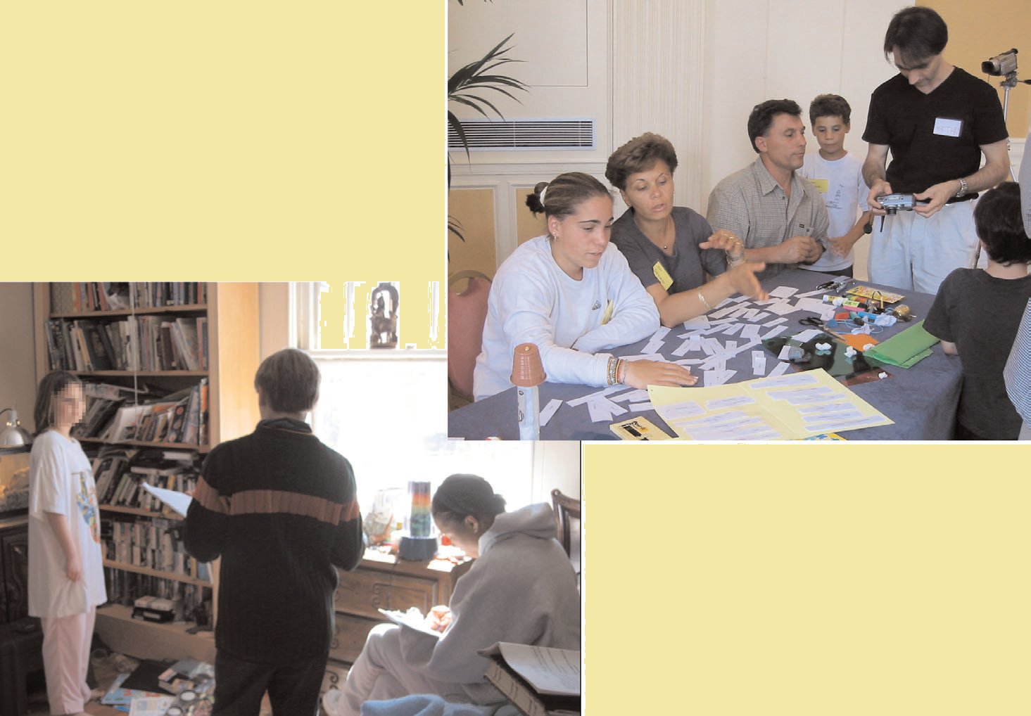
Participatory Design
3-<number>

Slide 16
Participatory Design (cont.)
Controversial
More user involvement brings:
  More accurate information about tasks
  More opportunity for users to influence design decisions
  A sense of participation that builds users' ego investment in successful implementation
  Potential for increased user acceptance of final system
3-<number>

Slide 17
Participatory Design (cont.)
On the negative side, extensive user involvement may:
  Be more costly
  Lengthen the implementation period
  Build antagonism with people not involved or whose suggestions rejected
  Force designers to compromise their design to satisfy incompetent participants
  Build opposition to implementation
  Exacerbate personality conflicts between design-team members and users
  Show that organizational politics and preferences of certain individuals are more important than technical issues
3-<number>

Slide 18
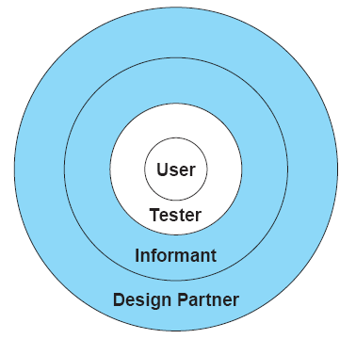
Participatory Design (cont.)
3-<number>

Slide 19
Scenario Development
Day-in-the-life scenarios:
Characterize what happens when users perform typical tasks
Can be acted out as a form of walkthrough
May be used as basis for videotape
Useful tools
  table of user communities across top, tasks listed down the side
  table of task sequences
  flowchart or transition diagram
3-<number>

Slide 20
Social Impact Statement for Early Design Review
Describe the new system and its benefits
Convey the high level goals of the new system
Identify the stakeholders
Identify specific benefits
3-<number>

Slide 21
Social Impact Statement for Early Design Review
Address concerns and potential barriers
Anticipate changes in job functions and potential layoffs
Address security and privacy issues
Discuss accountability and responsibility for system misuse and failure
Avoid potential biases
Weigh individual rights vs. societal benefits
Assess trade-offs between centralization and decentralization
Preserve democratic principles
Ensure diverse access
Promote simplicity and preserve what works
3-<number>

Slide 22
Social Impact Statement for Early Design Review
Outline the development process
Present and estimated project schedule
Propose process for making decisions
Discuss expectations of how stakeholders will be involved
Recognize needs for more staff, training, and hardware
Propose plan for backups of data and equipment
Outline plan for migrating to the new system
3-<number>

Slide 23
Legal Issues
Potential Controversies
What material is eligible for copyright?
Are copyrights or patents more appropriate for user interfaces?
What constitutes copyright infringement?
Should user interfaces be copyrighted?
Evolving public policies related to:
  Privacy
  Liability related to system safety/reliability
  Freedom of speech
3-<number>

Slide 24
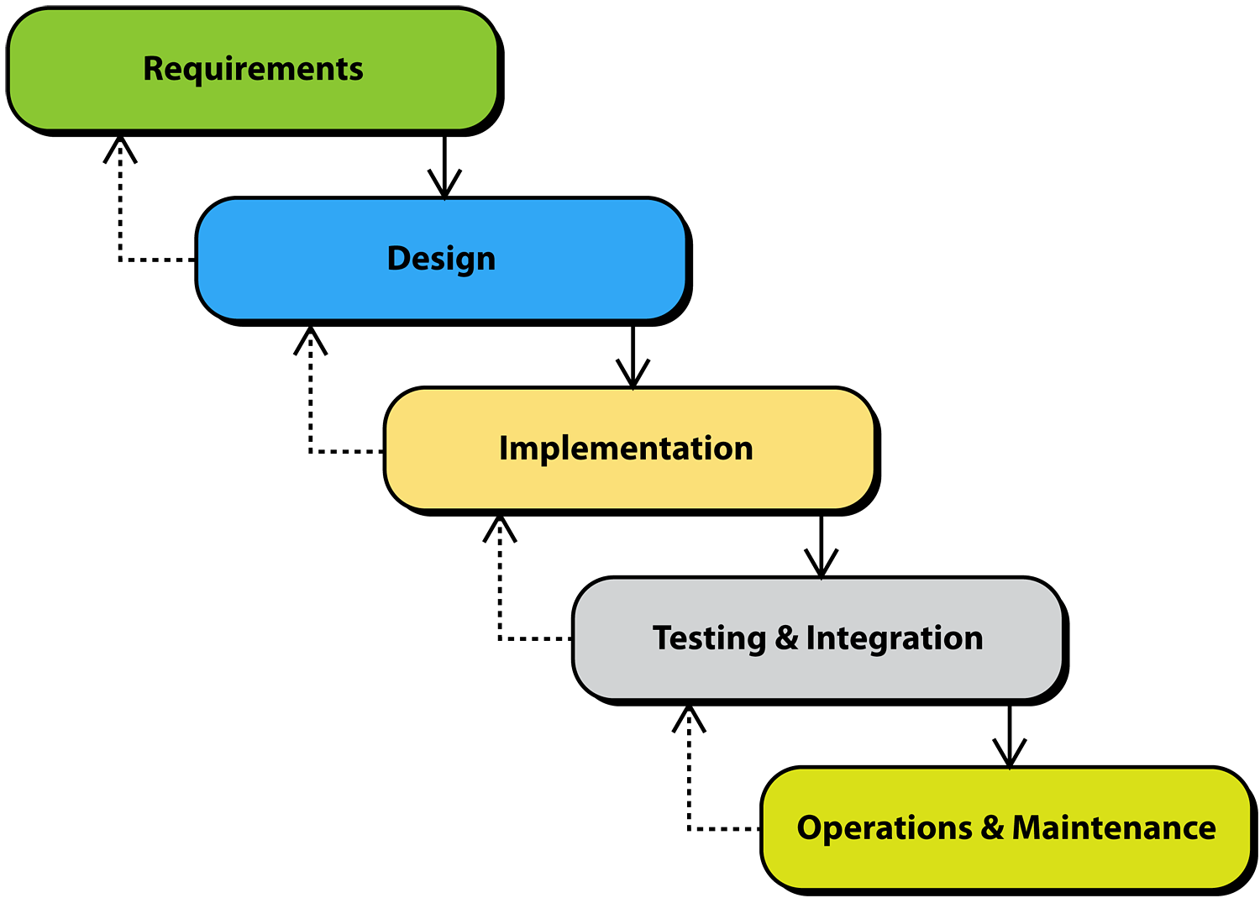
+ [Heim 2007]
Development Process: Waterfall Model
Traditional SE model (waterfall)
Emphasis is on systematic, step-wise development
Applicable when requirements are well-known
Doesn’t cope well with change

Slide 25
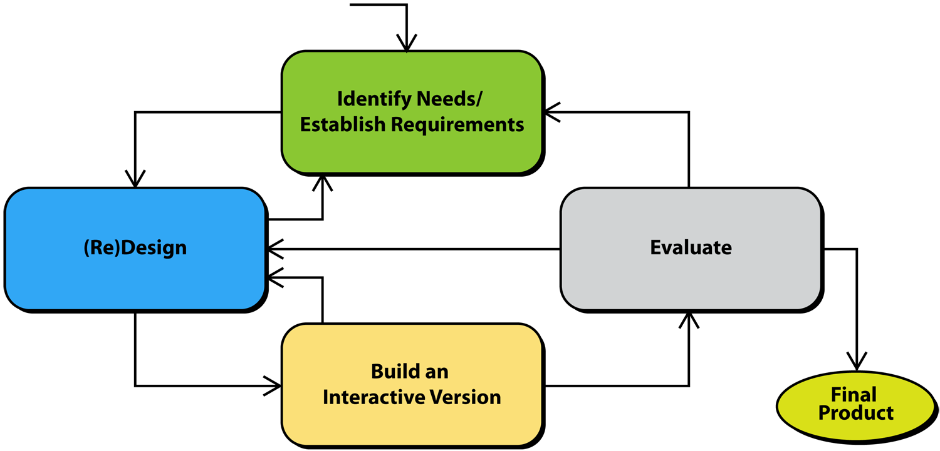
+ [Preece et al,2007]
Development Process: Basic HCI Model
Typical HCI model. Note that emphasis is on iteration, evaluation, and alternative versions.

Slide 26
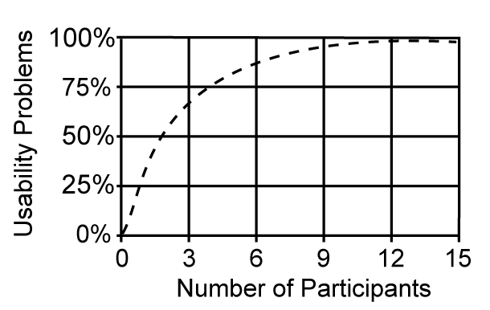
+ [Heim 2007]
DUE: Discount Usability Engineering
Nielsen suggested that the number of problems P that could be identified from a usability test with n users can be calculated according to the following equation:
P = N [1-(1-L)^{n}]
where:
N = total number of usability problems in a design
L = proportion of usability problems discovered with a single participant (31%)
n = number of users

Slide 27
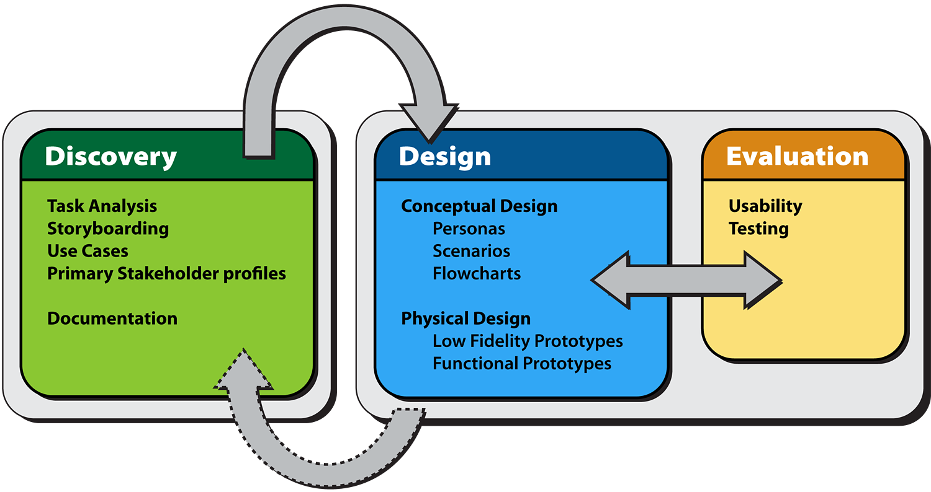
+ [Heim 2007]
Development Process: DDE Framework
DDE (Discovery, Design, Evaluation) Framework

Slide 28
Additional references
- Heim, S., The Resonant Interface: HCI Foundations for Interaction Design, Addison-Wesley, 2007.
- Jennifer Preece, Yvonne Rogers, and Helen Sharp, Interaction Design: Beyond Human-Computer Interaction, Wiley & Sons, 2007.
3-<number>

